Slide 1


AGI1252- Fundamentals of Data Science Using R
Department of Artificial Intelligence and Data Science
Academic Year: 2025 – 2026 (Even Semester)
BATCH 11
Year : II
Semester : IV
Section : B
Date : 05-05-2026

Slide 2

AN EMPIRICAL STUDY ON THE EFFECT OF DAILY SCREEN EXPOSURE ON SLEEP BEHAVIOUR
PRESENTED BY
OVIYA P (2403811724322072)
PRASHANTH G (2403811724321079)
RISHI P S (2403811724321092)
SHARMILA N (2403811724322107)
GUIDED BY
Mrs. Geetha S, M.E.,
Assistant Professor,
Department of AI&DS.

Slide 3
PRESENTATION OVERVIEW
Objective
Problem Identification
Flow Diagram
Literature Survey
Methodology
Hardware & Software requirements
Architecture Diagram
Modules Used
Modules Explanation
Implementation Screenshots
Conclusion

Slide 4
OBJECTIVE
To evaluate the impact of screen exposure on perceived sleep quality using appropriate statistical methods.

Slide 5
PROBLEM STATEMENT
Daily use of digital devices has increased screen exposure.
Excessive screen time can negatively affect sleep quality and duration.
Blue light from screens disrupts the natural sleep cycle.
Need for data-driven analysis using R programming language to study this impact.

Slide 6
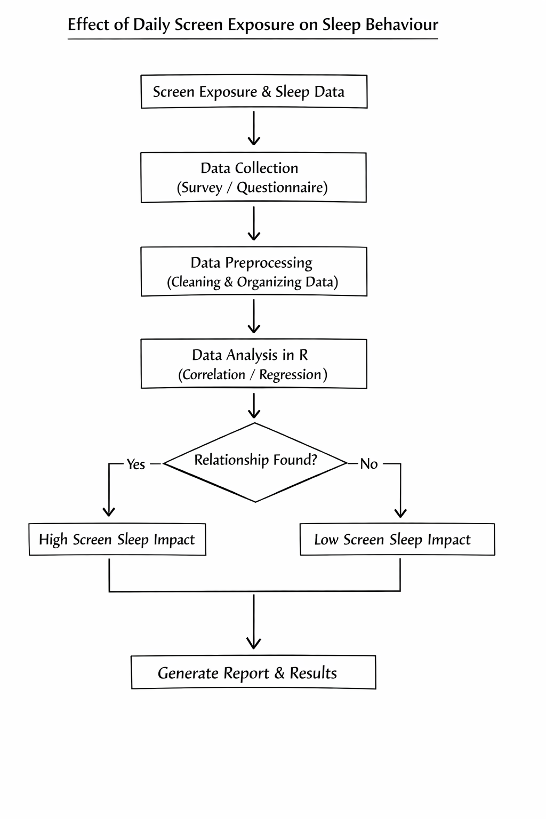
FLOW DIAGRAM

Slide 7
LITERATURE SURVEY
Literature Survey-R - Google Sheets
https://docs.google.com/spreadsheets/d/10Vi-aLxvQ_1YuG0tilQm-xQP-DYk0tl-wfYqgoGO4xk/edit?usp=drivesdk

Slide 8
METHODOLOGY
1. Descriptive Statistics Algorithm - summary(), mean(), sd()
This algorithm summarizes the basic features of screen time and sleep duration data.
It calculates mean screen exposure hours and average sleep hours.
It helps understand overall trends before deeper analysis.

Slide 9
METHODOLOGY
2. Pearson Correlation Algorithm – cor()
This algorithm measures the relationship between daily screen time and sleep duration.
It gives a value between -1 and +1 to show strength and direction.
A negative value indicates that higher screen time reduces sleep hours.

Slide 10
METHODOLOGY
3. Linear Regression Algorithm – lm()
This algorithm predicts sleep behaviour based on daily screen exposure.
It creates a regression model to show how screen time affects sleep duration.
It helps determine whether screen exposure significantly impacts sleep patterns.

Slide 11
HARDWARE AND SOFTWARE REQUIREMENTS
Hardware Requirements
A computer/laptop with minimum 4 GB RAM
Processor: Intel i3 or above (or equivalent)
Storage: At least 20 GB free space
Software Requirements
R programming language
RStudio
Operating System (Windows / macOS / Linux)
Required R packages (ggplot2, dplyr, tidyverse)

Slide 12
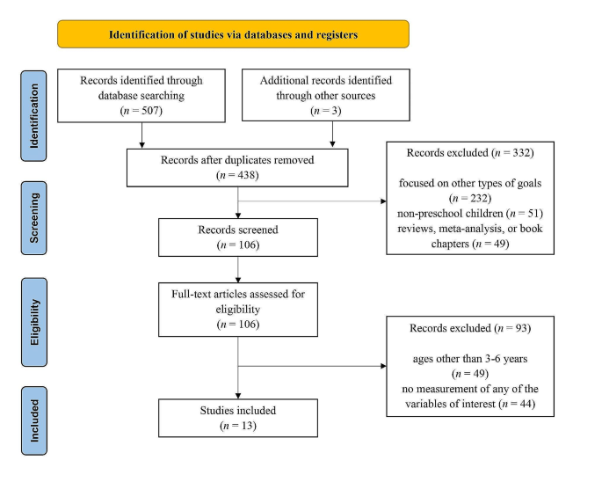
ARCHITECTURE DIAGRAM

Slide 13
MODULE DESCRIPTION
1. Participant Profiling Module
2. Digital Exposure Assessment Module
3. Sleep Behavior Analysis Module
4. Statistical Analysis Module
5. Visualization and Reporting Module
6. Notification Impact Module

Slide 14
MODULE DESCRIPTION
1. Participant Profiling Module
This module collects and records the basic details of the participants involved in the study, such as age, gender, and occupation. These attributes help classify participants into different demographic groups. By organizing this information, the study can analyze how different groups respond to screen exposure and its effect on sleep behaviour.

Slide 15
MODULE DESCRIPTION
2. Digital Exposure Assessment Module
The Digital Exposure Assessment Module measures the amount and pattern of daily screen usage across devices such as smartphones, laptops, and tablets. It tracks factors like total screen time, frequency of use, and exposure during critical periods such as before bedtime. Using R programming language, the module analyzes this data to identify trends and assess how varying levels of digital exposure may influence sleep behaviour and overall sleep quality.

Slide 16
MODULE DESCRIPTION
3. Sleep Behavior Analysis Module
This module examines sleep-related factors including sleep duration, sleep quality, and sleep patterns. It helps identify possible sleep disturbances caused by excessive screen usage. The analysis helps determine how digital exposure may influence healthy sleep behaviour.

Slide 17
MODULE DESCRIPTION
4. Statistical Analysis Module
This module applies statistical techniques to study the relationship between screen exposure and sleep behaviour. Methods such as correlation and regression analysis are used to evaluate the strength of the relationship between variables. The results help provide scientific evidence for the study.

Slide 18
MODULE DESCRIPTION
5. Visualization and Reporting Module
This module analyzes the influence of device notifications such as messages, calls, and alerts. Frequent notifications may interrupt sleep or delay bedtime. By studying notification patterns, the module helps understand how digital interruptions affect sleep quality.

Slide 19
MODULE DESCRIPTION
6. Notification Impact Module
The Notification Impact Module evaluates how frequent and late-night device notifications influence screen time and sleep behaviour. It considers factors like the number, timing, and type of notifications, and how users respond to them. By analyzing this data using R programming language, the module identifies patterns showing how notifications may lead to sleep disturbances, delayed sleep, or poor sleep quality.

Slide 20
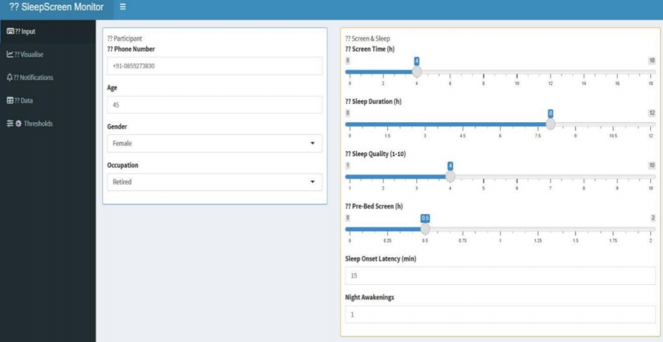
IMPLEMENTATION SCREENSHOTS
Participant Profiling Data

Slide 21
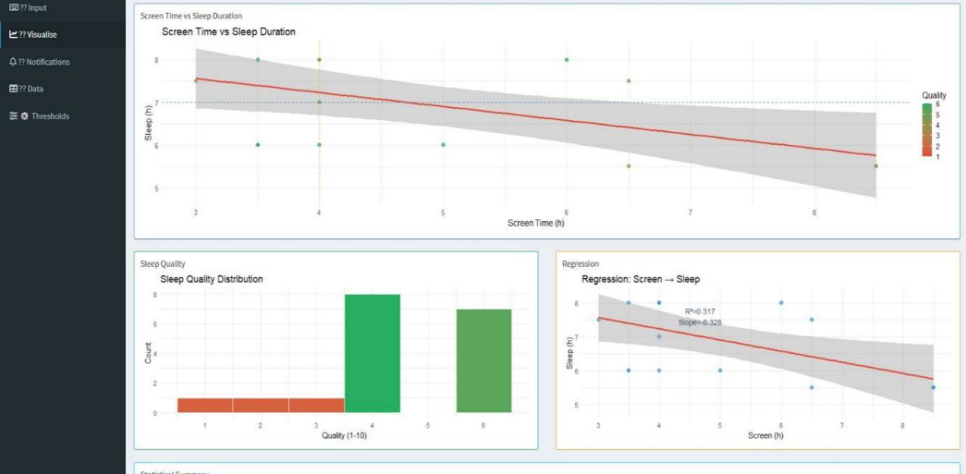
IMPLEMENTATION SCREENSHOTS
Dashboard & Visualization

Slide 22
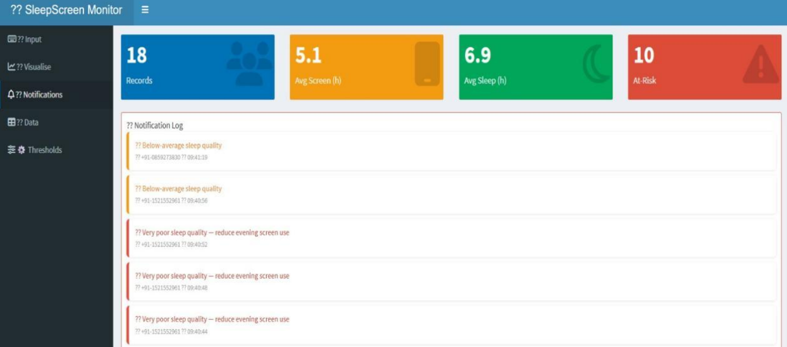
IMPLEMENTATION SCREENSHOTS
Notification Impact

Slide 23
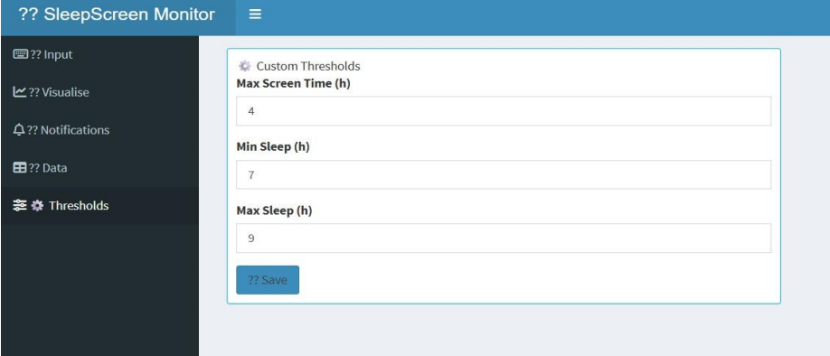
IMPLEMENTATION SCREENSHOTS
Threshold Management

Slide 24
CONCLUSION
This program explores the connection between daily screen exposure and sleep behaviour using empirical analysis. It emphasizes the growing influence of digital habits on sleep patterns in modern lifestyles. The findings contribute to better awareness of maintaining balanced screen usage for healthier living.

Slide 25
THANK YOU !!!

